Slide 1

Data Science Final Capstone Project Presentation 17-Dec-2019

Slide 2
1) Business Understanding (Description of Problem)
Problem is which city and street in Australia is the best to open Hotel?
Background is that my client is a business man in Asia. And he would like to expand his business in another countries. So He would like to open Hotel but not sure in which city and location in Australia.
2) Analytic Approach
As per request of customer, we must find State, City and location where is the best for his business. Meanwhile need to collect data to look for the best location, Then his business would be successful.
To support the business, the location must meet
1) Population Density
2) Transport
3) Food
4) Cafe
5) Restaurant
6) Park

Slide 3
3) Description of Data
To solve the problem, we need the data
data for all state and city with population density
data for venues in each city
data for venues in each locality in selected city
Source of Data
https://simplemaps.com/data/au-cities
Import the csv file to get the population of Australia.
Four Square API
For Venues in City and in Each locality in selected city.
Data Description (How to use Data to solve the Problem?)
By Using the data from world population site, firstly we choose most population state and city then will choose we can focus on and open Hotel in which location according to the data. Then by leveraging the Foursquare data, we will compare and try to find the best locality. Based on weights we will try to determine the Locality in similar way.

Slide 4
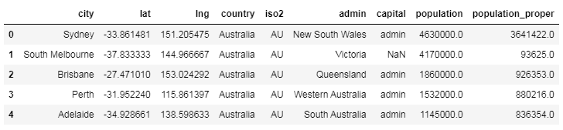
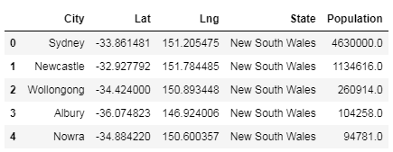
Import Data with csv file for Australia Data Source
1) Firstly import data with csv file
2) Remove unnecessary column and updated the column name
3) Choose the State with highest population

Slide 5
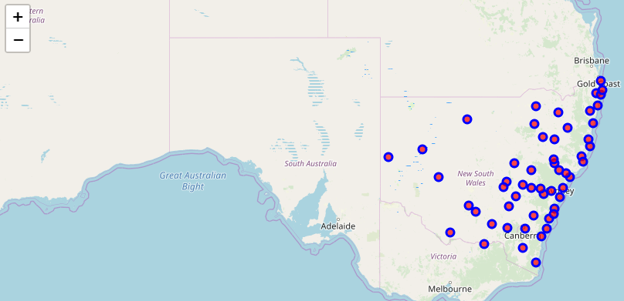
Visualization - Drawing City Map of New South Wales State

Slide 6
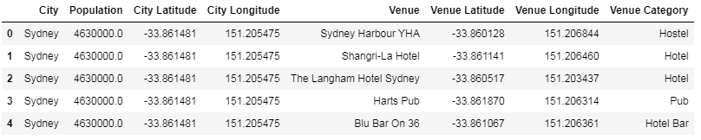
Finding Venues for all city and get particular city
It has 49 cities and 124 Venue Category.
Get the city with most population and related venues.
Take Sydney with -33.861481 Lat and 151.205475 long location and its related 50 venues using Foursquare API

Slide 7
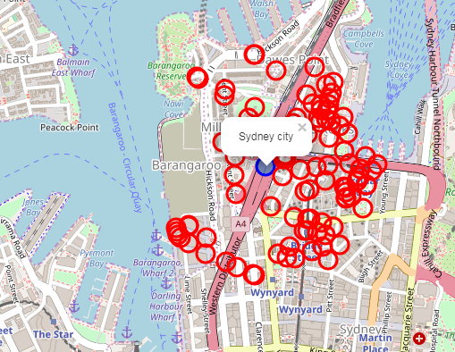
Visualization - Drawing Sydney City Map of New South Wales State

Slide 8
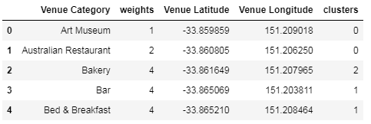
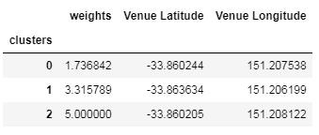
Apply K-mean cluster for segmentation of venue category

Slide 9
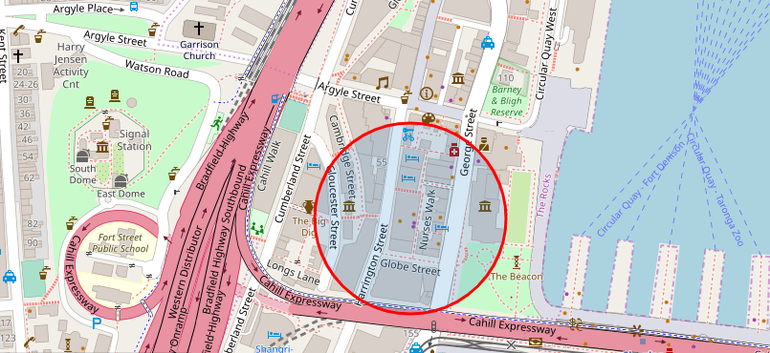
Visualization - Drawing map near by Venue location to open Hotel

Slide 10

Conclusion
Finally choose high weights with cluster and venue.
Sydney city in New South Wales of Australia is the best to open Hotel and focus on near red circle such as Harrington street.

